Slide 1
Enhanced Entity-Relationship (EER) Modeling

Slide 2
Chapter Outline
EER stands for Enhanced ER or Extended ER
EER Model Concepts
  Includes all modeling concepts of basic ER
  Additional concepts:
    subclasses/superclasses
    specialization/generalization
    attribute and relationship inheritance
  These are fundamental to conceptual modeling
The additional EER concepts are used to model applications more completely and more accurately
  EER includes some object-oriented concepts, such as inheritance
Slide 4- <number>

Slide 3
Subclasses and Superclasses (1)
An entity type may have additional meaningful subgroupings of its entities
  Example: EMPLOYEE may be further grouped into:
    SECRETARY, ENGINEER, TECHNICIAN, …
      Based on the EMPLOYEE’s Job
    MANAGER
      EMPLOYEEs who are managers
    SALARIED_EMPLOYEE, HOURLY_EMPLOYEE
      Based on the EMPLOYEE’s method of pay
EER diagrams extend ER diagrams to represent these additional subgroupings, called subclasses or subtypes
Slide 4- <number>

Slide 4

Subclasses and Superclasses
Slide 4- <number>

Slide 5
Subclasses and Superclasses (2)
Each of these subgroupings is a subset of EMPLOYEE entities
Each is called a subclass of EMPLOYEE
EMPLOYEE is the superclass for each of these subclasses
These are called superclass/subclass relationships:
  EMPLOYEE/SECRETARY
  EMPLOYEE/TECHNICIAN
  EMPLOYEE/MANAGER
  …
Slide 4- <number>

Slide 6
Subclasses and Superclasses (3)
These are also called IS-A relationships
  SECRETARY IS-A EMPLOYEE, TECHNICIAN IS-A EMPLOYEE, ….
Note: An entity that is member of a subclass represents the same real-world entity as some member of the superclass:
  The subclass member is the same entity in a distinct specific role
  An entity cannot exist in the database merely by being a member of a subclass; it must also be a member of the superclass
  A member of the superclass can be optionally included as a member of any number of its subclasses
Slide 4- <number>

Slide 7
Subclasses and Superclasses (4)
Examples:
  A salaried employee who is also an engineer belongs to the two subclasses:
    ENGINEER, and
    SALARIED_EMPLOYEE
  A salaried employee who is also an engineering manager belongs to the three subclasses:
    MANAGER,
    ENGINEER, and
    SALARIED_EMPLOYEE
It is not necessary that every entity in a superclass be a member of some subclass
Slide 4- <number>

Slide 8

Representing Specialization in EER Diagrams
Slide 4- <number>

Slide 9
Attribute Inheritance in Superclass / Subclass Relationships
An entity that is member of a subclass inherits
  All attributes of the entity as a member of the superclass
  All relationships of the entity as a member of the superclass
Example:
  In the previous slide, SECRETARY (as well as TECHNICIAN and ENGINEER) inherit the attributes Name, SSN, …, from EMPLOYEE
  Every SECRETARY entity will have values for the inherited attributes
Slide 4- <number>

Slide 10
Specialization (1)
Specialization is the process of defining a set of subclasses of a superclass
The set of subclasses is based upon some distinguishing characteristics of the entities in the superclass
  Example: {SECRETARY, ENGINEER, TECHNICIAN} is a specialization of EMPLOYEE based upon job type.
    May have several specializations of the same superclass
Slide 4- <number>

Slide 11
Specialization (2)
Example: Another specialization of EMPLOYEE based on method of pay is {SALARIED_EMPLOYEE, HOURLY_EMPLOYEE}.
  Superclass/subclass relationships and specialization can be diagrammatically represented in EER diagrams
  Attributes of a subclass are called specific or local attributes.
    For example, the attribute TypingSpeed of SECRETARY
  The subclass can also participate in specific relationship types.
    For example, a relationship BELONGS_TO of HOURLY_EMPLOYEE
Slide 4- <number>

Slide 12
Specialization (3)
Slide 4- <number>

Slide 13
Generalization
Generalization is the reverse of the specialization process
Several classes with common features are generalized into a superclass;
  original classes become its subclasses
Example: CAR, TRUCK generalized into VEHICLE;
  both CAR, TRUCK become subclasses of the superclass VEHICLE.
  We can view {CAR, TRUCK} as a specialization of VEHICLE
  Alternatively, we can view VEHICLE as a generalization of CAR and TRUCK
Slide 4- <number>

Slide 14

Generalization (2)
Slide 4- <number>

Slide 15
Generalization and Specialization (1)
Diagrammatic notation are sometimes used to distinguish between generalization and specialization
  Arrow pointing to the generalized superclass represents a generalization
  Arrows pointing to the specialized subclasses represent a specialization
  We do not use this notation because it is often subjective as to which process is more appropriate for a particular situation
  We advocate not drawing any arrows
Slide 4- <number>

Slide 16
Constraints on Specialization and Generalization
Two basic constraints can apply to a specialization/generalization:
  Disjointness Constraint:
  Completeness Constraint:
Slide 4- <number>

Slide 17
Constraints on Specialization and Generalization (4)
Disjointness Constraint:
  Specifies that the subclasses of the specialization must be disjoint:
    an entity can be a member of at most one of the subclasses of the specialization
  Specified by d in EER diagram
  If not disjoint, specialization is overlapping:
    that is the same entity may be a member of more than one subclass of the specialization
  Specified by o in EER diagram
Slide 4- <number>

Slide 18
Constraints on Specialization and Generalization (5)
Completeness Constraint:
  Total specifies that every entity in the superclass must be a member of some subclass in the specialization/generalization
  Shown in EER diagrams by a double line
  Partial allows an entity not to belong to any of the subclasses
  Shown in EER diagrams by a single line
Slide 4- <number>

Slide 19
Constraints on Specialization and Generalization (6)
Hence, we have four types of specialization/generalization:
  Disjoint, total
  Disjoint, partial
  Overlapping, total
  Overlapping, partial
Note: Generalization usually is total because the superclass is derived from the subclasses.
Slide 4- <number>

Slide 20
Example of disjoint partial Specialization
Slide 4- <number>

Slide 21

Example of overlapping total Specialization
Slide 4- <number>

Slide 22
Specialization/Generalization Hierarchies, Lattices & Shared Subclasses (1)
A subclass may itself have further subclasses specified on it
  forms a hierarchy or a lattice
Hierarchy has a constraint that every subclass has only one superclass (called single inheritance); this is basically a tree structure
In a lattice, a subclass can be subclass of more than one superclass (called multiple inheritance)
Slide 4- <number>

Slide 23

Shared Subclass “Engineering_Manager”
Slide 4- <number>

Slide 24
Specialization/Generalization Hierarchies, Lattices & Shared Subclasses (2)
In a lattice or hierarchy, a subclass inherits attributes not only of its direct superclass, but also of all its predecessor superclasses
A subclass with more than one superclass is called a shared subclass (multiple inheritance)
Can have:
  specialization hierarchies or lattices, or
  generalization hierarchies or lattices,
  depending on how they were derived
We just use specialization (to stand for the end result of either specialization or generalization)
Slide 4- <number>

Slide 25
Specialization/Generalization Hierarchies, Lattices & Shared Subclasses (3)
In specialization, start with an entity type and then define subclasses of the entity type by successive specialization
  called a top down conceptual refinement process
In generalization, start with many entity types and generalize those that have common properties
  Called a bottom up conceptual synthesis process
In practice, a combination of both processes is usually employed
Slide 4- <number>

Slide 26

Specialization / Generalization Lattice Example (UNIVERSITY)
Slide 4- <number>

Slide 27
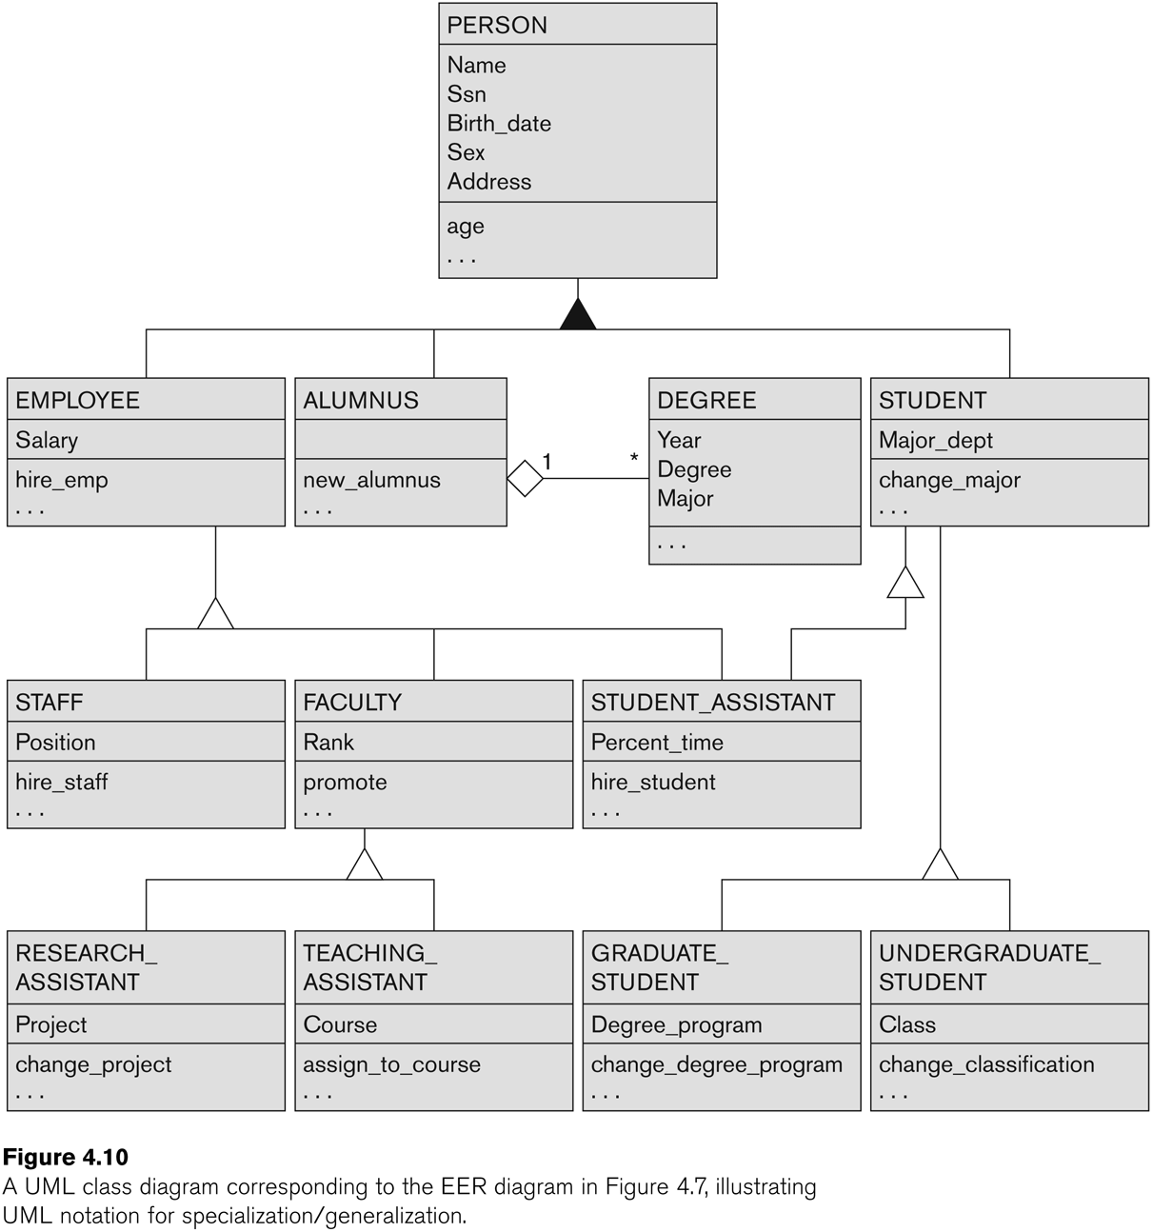
UML Example for Displaying Specialization / Generalization
Slide 4- <number>

